Slide 1


Innovative Report on
NEW TECHNOLOGIES IN MANAGEMENT
Submitted By:
KUMAR APURVA
2K18/MC/058
Mathematics and Computing – 5th Semester
Under the Guidance of :
Dr. ABHINAV CHAUDHARY
ASSISTANT PROFESSOR
August-December 2020
Delhi Technological University
Bawana Road Delhi 110042

Slide 2

NEW TECHNOLOGIES IN MANAGEMENT
KUMAR APURVA 2K18/MC/058

Slide 3
THE NEW ERA OF TECHNOLOGY
Our daily lives have been transformed and influenced by new technology. In just over 10 years, we’ve witnessed the rise of the smartphone, cloud computing, artificial intelligence and the smart world of connected devices. We live in an era of high technology, the speed of development of which is increasing every day.
Over the years, technology has revolutionized our world and daily lives. Technology has created amazing tools and resources, putting useful information at our fingertips. Modern technology has paved the way for multi-functional devices like the smartwatch and the smartphone. Computers are increasingly faster, more portable, and higher-powered than ever before. With all of these revolutions, technology has also made our lives easier, faster, better, and more fun. Technology’s advancements have provided quicker ways to communicate through instant messaging apps and social media platforms.

Slide 4

THE DIGITAL INDIA PROGRAMME
Many countries are trying to use the new technologies to its full extent and are trying to be fully digital. India itself launched a programme known as the Digital India programme on July, 2015 which is a flagship programme of the government of India with a vision to transform India into a digitally empowered society and knowledge economy. “faceless, paperless, cashless” is one of professed role of Digital India.

Slide 5

IMPORTANCE OF MANAGEMENT
Management is the process of guiding the development, maintenance, and allocation of resources to attain organizational goals. Managers are the people in the organization responsible for developing and carrying out this management process. Management is dynamic by nature and evolves to meet needs and constraints in the organization’s internal and external environments. In a global marketplace where the rate of change is rapidly increasing, flexibility and adaptability are crucial to the managerial process. This process is based in four key functional areas of the organization: planning, organizing, leading, and controlling.

Slide 6
IMPORTANCE OF MANAGEMENT
The managerial process can be described as :
Anticipating potential problems or opportunities and designing plans to deal with them.
Coordinating and allocating the resources needed to implement plans.
Guiding personnel through the implementation process.
Reviewing results and making any necessary changes.
Thus the cycle starts over again. The four functions are highly interdependent, with managers often performing more than one of them at a time and each of them many times over the course of a normal workday.

Slide 7
ROLE OF TECHNOLOGY IN MANAGEMENT
OVERVIEW
The role of technology in modern age business management has revolutionized business models and concepts, causing increased productivity and tremendous growth.
The use of technology has given new and better approach to the conventional business models by replacing them with a more convenient, faster, and efficient way of performing business operations and transactions.
Essentially, advancements in technology have ensured greater efficiency in business, improving productivity, automating data processing, and enhancing business performance. Particularly when it comes to dealing with each and every step of the business management process, everything from accounting systems to management information systems has seen a makeover with the use of technology.

Slide 8
1. DATA ANALYTICS
Data analytics is the process of selecting relevant data with the purpose of researching and making decisions based on the information it provides and managing that data.
This analysis is done in an effort to prove or disprove current business assumptions and improve decision making in the business environment as well as perform maintenance operations on business functions.
With the amount of data a business has, it has the potential to aggregate and leverage for greater efficiency is staggering - market trends, consumer behavior, demographics, retail sales, competitor pricing.

Slide 9
EXAMPLE OF DATA ANALYTICS
An example of a key area where data analysis can be valuable is in enterprise risk management (ERM).
With the right knowledge and expertise, management can eliminate redundant systems and other operational risk factors that can drain the bottom line if left unnoticed.
To provide businesses the ability to access information, risk management information systems are used to manage and process specialized data in the attempt to examine risk control and risk financing.
ERM can also help to identify missing opportunities in a work place or departments where maintenance costs exceed profitability.

Slide 10
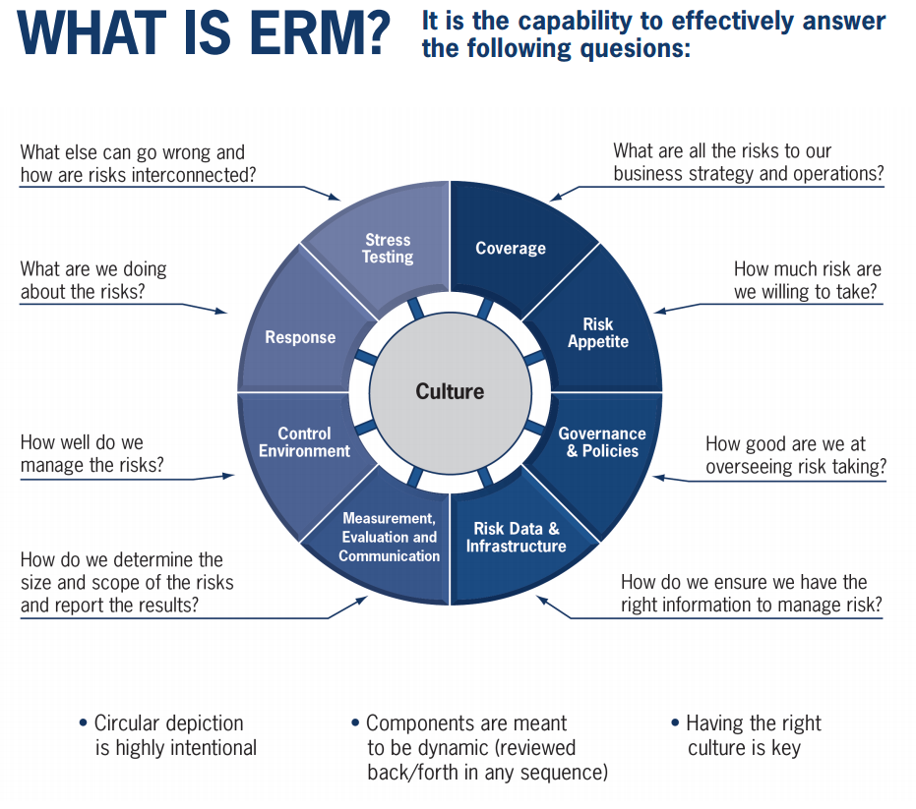
WHAT IS ERM ?

Slide 11

2. SATELLITE WORKERS
With so many individuals working from home offices now, keeping tabs on employees has become more complicated than simply peeking over the nearest cubicle wall. Only with the use of technology can management hope to have an accurate barometer with which to measure the output from remote workers or satellite offices.

Slide 12


TOOLS FOR SATELLITE WORKERS
Time Doctor is one example of a program used to keep track of what exactly employees are working on and how much time they have spent on those tasks. To increase collaboration, Time Doctor is used to manage attendance and improve productivity of an online workforce to help ensure they become highly efficient.
Another alternative is Toggl, an online time tracking tool which is easy to set up and use. It integrates with project management tools such as Basecamp and can be operated from anywhere with internet access. This tool makes it easy to generate reports based on time spent on specific projects or by teams of employees. Additionally, it is compatible with any operating system and there is an app for iPhone and Android users if they have to be away from their computers.

Slide 13
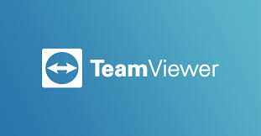




SHARING TOOLS FOR SATELLITE WORKERS
Sharing tools are also available for employees to be able to share their screen with managers to add a visual aspect when explaining certain tasks. Tools such as TeamViewer provide managers the ability to better monitor progress and the efficiency of their satellite staff. Other well-known methods for online collaboration include:
Jing Project: share screen and video captures of desktops that can include voiceovers or annotations to share information.
Google Drive: online spreadsheets in a central location for multiple individuals to retrieve simultaneously, an alternative to Excel or Word documents.
Dropbox: a simple way to share and store documents that can be accessed by employees.
SharePoint by Microsoft: a secure place to store, organize, share, and access information from almost any device.

Slide 14
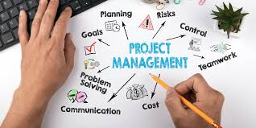
3. PROJECT MANAGEMENT
Project management encompasses a variety of aspects including budget and deadline management, tracking tasks, and streamlining communication. Teams, regardless of where they are located, have technologies available to organize and monitor the lifecycle of different projects. To effectively use technology to manage projects, managers must have both the business experience to understand processes and the technological training to recognize which program implementations will save time and money.

Slide 15
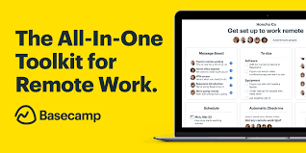

TOOLS FOR PROJECT MANAGEMENT
The technology used is Basecamp, an online project management tool, has made it easier to manage projects and communication by optimizing workflow in a simplistic way. Managers can also send internal messages, have discussions through Basecamp, and automate certain business processes which allows for a one-stop-shop in project management.
Managers should also be aware of tools that can help save data as well such as automated backup services like Carbonite. It is an efficiency product that allows employees to access data from anywhere in addition to backing up each and every user’s hard drive to the cloud, just in case something happens or an older version is needed.

Slide 16

4. COMMUNICATION METHODS
For today’s businesses, global competition is a topic of discussion, and those who intend to compete must be comfortable using communication technology in situations where physically meeting is not a possibility. People can now speak face to face, in real time, with a team of clients on the other side of the world.
These programs have made it possible for managers to have a more personal relationship with staff, rather than using previous methods such as email or traditional phone calls.

Slide 17


TOOLS FOR COMMUNICATION METHODS
Services such as Skype or other video conference call systems help managers keep in touch with remote workers over the internet. Other strategies for maintaining communication between employees include chat rooms, discussion groups and forums, and Google+ hangouts.
Maintaining communication with teams, whether remote or in office, is an essential tool for company leaders. Managers have a responsibility to implement the appropriate technologies to encourage collaboration, maximize efficiency, produce the best company results, and to direct employees in an appropriate way.

Slide 18
5. DEVELOPING CUSTOMER RELATIONSHIP
Industry Today suggests that businesses can develop strong customer relationships by using tools like customer relationship management (CRM) software.
This management technology oversees all the interactions the company has with each customer. For example, the company can integrate CRM software with their website and other systems to track resources the customer downloaded from the website or learn who they spoke to in customer service.
Having all this insight on their customers and prospects in one place provides management with a deeper understanding of their audience. This way, businesses can learn more details about the kinds of challenges their customers face, what types of questions they ask most frequently, and the level of service they expect. This helps managers develop new products and services as well as customer service policies.

Slide 19
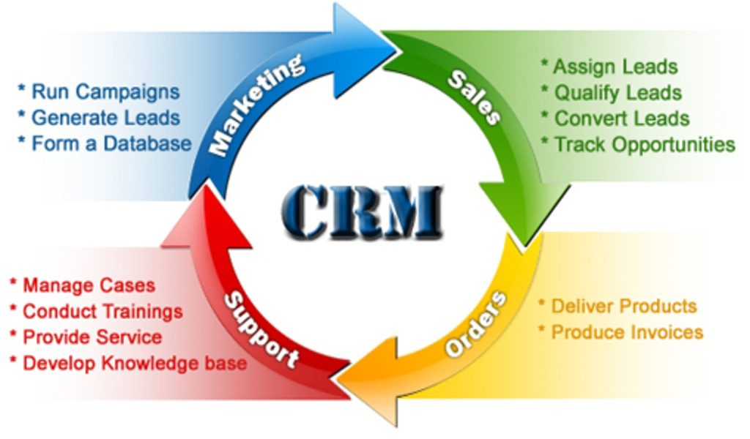
CYCLE OF CRM

Slide 20
6. SECURITY
Business workplace at its every level demands a great level of security for its safe running. Technology plays a vital part in doing so. It provides an end-to-end hardware and software-based data encryption so that only authorized parties are able to retrieve and read it. Fingerprint and facial recognition features give an added level of security to the systems at the workplace.
The companies are using innovative technology and implementing security software and algorithms to make sure that sensitive information is accessible to the right people and is protected from malicious hacking attempts.
It has also become easier to keep a check on the employee’s’ online communication and activities to ensure that they don’t get involved in any practice which is against the interest of the company.

Slide 21
NEW TECHNOLOGIES IN MANAGEMENT
Technology today has created an impact on every aspect of human life, and its effects on the business world are no exception. In fact, ‘technology’ has been constantly synonymous with ‘advancement’, and thus has been making its impact immense, constant, and enduring in the professional sphere.
The role and significance of technology in business management are becoming a growing necessity and as years go by, the world of business management would make it inseparable.
Since technology paves way for innovation and innovation breeds business, it is obvious that businesses require technology to sustain their growth in this fast advancing world. Indeed, most of the business operations and proceedings today involve the use of technology in some way or the other.

Slide 22
INTERNET OF THINGS
The Internet of things (IoT) describes the network of physical objects—“things”—that are embedded with sensors, software, and other technologies for the purpose of connecting and exchanging data with other devices and systems over the Internet.
IoT is driving business changes by providing the data needed to improve marketing, increase sales, and decrease costs.
And while a gadget that connected to the internet may once have been a novelty, more consumers are demanding devices that upload and receive data.

Slide 23
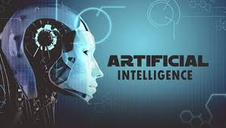
ARTIFICIAL INTELLEGENCE (AI)
Artificial intelligence (AI) refers to the simulation of human intelligence in machines that are programmed to think like humans and mimic their actions. The term may also be applied to any machine that exhibits traits associated with a human mind such as learning and problem-solving. AI is already significantly impacting the way customers interact with businesses via intelligent websites and bots.
"The largest impacts across all industries from retail to healthcare, hospitality to finance are felt when AI improves data security, decision-making speed and accuracy, and employee output and training," Maddy Martin, head of growth and education for Smith.ai, said in the release.

Slide 24


CHATBOTS
A chatbot is an artificial intelligence (AI) software that can simulate a conversation (or a chat) with a user in natural language through messaging applications, websites, mobile apps or through the telephone.
A chatbot is often described as one of the most advanced and promising expressions of interaction between humans and machines.
Services like Zoho and LiveChat can help the company deliver automated customer service across multiple channels, track and respond to inquiries as needed, and learn from the data your customers give .

Slide 25
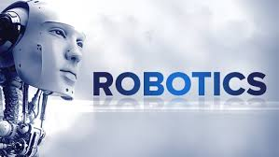
ROBOTICS
Robotics is automating routine processes by using machines to make businesses faster, less expensive and more efficient.
Robotic process automation (RPA) is an excellent example of advanced technology for Businesses.
Automated bots are excellent at carrying out repetitive jobs much faster and with much more precision than human counterparts.
Bots are pieces of software specifically configured to perform particular tasks, like data entry; supply chain management; and data gathering.
Bots can operate these complex functions 24/7 without assistance and make fewer mistakes than humans.

Slide 26

5G
The rise of 5G networks is increasing our ability to move, manipulate, and analyze data across wireless platforms. As 5G rolls out more fully in the coming years, it will drive the development of more complex apps to solve problems and increase growth across industries.
The development and deployment of 5G is going to enable business impact at a level few technologies ever have, providing wireless at the speed and latency needed for complex solutions like driverless vehicles.

Slide 27
CLOUD COMPUTING
Cloud computing refers to the provision of IT infrastructure, operating software, middleware and applications hosted within a datacentre and accessed by the end user via the Internet.
Cloud computing is typically sold using three service models:
Infrastructure as a service (IaaS): a model for renting out IT hardware, such as servers, data centre space or networking components, to IT systems administrators or network architects, saving them the cost of buying and building their own in-house data centre.
Platform as a service (PaaS): a model for providing IT platforms to allow app developers to create, run and manage applications without the complexity of building and maintaining the infrastructure typically associated with developing and launching an app.
Software as a service (SaaS): a model for licensing and delivering centrally hosted software via the Internet on a subscription basis to corporations and consumers.

Slide 28
CLOUD COMPUTING IN BUSINESS
Cloud computing makes it easier, cheaper and faster to run state-of-the-art IT architectures in any type of company, large or small. The key benefits are:
Cost: Significant cost savings are likely across a company’s IT budget.
Flexibility: Businesses can rent IT equipment and applications as needed, rather than buying hardware and software assets outright.
Scalability: Computing capabilities like storage, processing power or network bandwidth can be scaled-up almost instantly and scaled-down again depending on demand and users are unlikely to ever be short of capacity.
Ubiquitous access: IT resources can be accessed by any authorized users on any authorized devices from any authorized location using an Internet connection.

Slide 29

BLOCK CHAIN
Blockchain is a network spread across public or private computers that stores real-time records of transactions between people or companies. Because the record of the transaction is available to everyone in the network, it’s harder to commit fraud. Purchases made with Bitcoin cut out the middleman viz banks that moves money around and verify transactions.
With blockchain, networks of other people and computers provide the checks and balances. The businesses with the ability to take payments in Bitcoin will see some financial advantages. Unlike processing credit cards, Bitcoin eliminates transaction fees. And because the virtual currency doesn’t recognize a country, you won’t have to worry about exchange rates either.

Slide 30



SMART PAYMENT
Consumers may not be ready to switch some – or most – of their assets over to Bitcoin, but they’re still going digital with mobile or “smart” payments like Paytm, Phonepe, Google Wallet etc.
As with other areas of businesses where tech and payment processing collide, company needs to pay special attention to the security of their customers’ financial information and prepare staff to integrate payments into existing accounting processes.

Slide 31
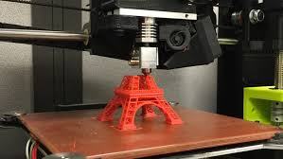
3D PRINTING
3D printing offers a solution for the low volume manufacturing of complex parts, as well as fast local production of difficult-to-find products. As more affordable products become available, opportunities for this industry will continue to grow.
3D technology also makes personalization and customization easier and more affordable for companies to offer their customers.
It can play a significant role especially in manufacturing and trade. Where once small businesses lacked funding or space to produce goods at the same rate as larger companies, 3D printers offer an affordable way to scale.

Slide 32
Virtual reality (VR)/Augmented reality (AR)
Using VR, AR, mixed reality, AI, and sensor technologies can help organizations improve operational efficiency and individual performance.
Some of these VR budgets are bound to go toward making virtual prototypes or branding products that are expensive and time-consuming to produce.
For example, Six Flags used VR technology to help name their newest coaster instead of waiting to build, brand, and test their coaster on audiences in real time.
It could be possible in future that when you’re working from home and the regional office calls a meeting, you could simply slide on your VR display to see the team in your living room.
As this technology becomes more affordable, investments in remote work capabilities will only help companies cut down on costs associated with office and employee management.

Slide 33
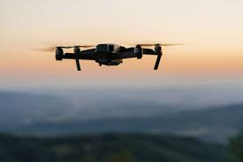
DRONES
Security Surveillance
Search and Rescue
Commercial, Industrial, and Insurance Inspections
Delivery

Slide 34
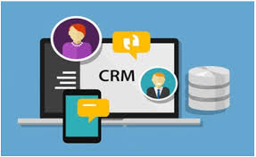
Customer-relationship management (CRM) software
CRM software includes any application that a business uses to interact with customers, analyze data, or recommend products and services to customers.
This type of software helps your team manage, control and build customer relationships. It can log your team's touchpoints with prospects, including emails, phone calls, voicemails and in-person meetings.
Company can have a complete record of your team's interaction with a prospect that's easy for anyone to access.

Slide 35
DOCUMENT DATA EXTRACTION
Intelligent methods for extracting data and processing them are another example of advanced technology that can be a huge benefit to a modern business.
Workers have for many years become accustomed to transcribing data from a document and manually entering it into a system of record.
Combined with machine learning, its capabilities of handling data improve the more the system is used. This is especially useful when dealing with unstructured documents.
Vendors like DocuWare are increasingly able to provide these functions to Businesses in full with affordability in mind.

Slide 36
WORKFLOW TOOLS
One of the chief concerns of a business undergoing a digital transformation is improving data workflow within the organization. With the advanced technology of solutions like Enterprise Content Management, digitized data can now be efficiently processed and stored.
From here, it’s a relatively simple step to get that data downstream to the right people at the right time, regardless of department. Workflow tools, specifically cloud-based systems, are excellent at proving platforms for organizing work processes and projects within teams.
The functionality of these tools extends to management best practices, such as approval routing, data validation, and ensuring the integrity of data before it goes into your ERP system.

Slide 37
BIG DATA PROCESSING TOOLS
Big data is everywhere – it’s what powers the Google Analytics insights company use to study their website traffic, or how they track and learn about their customers’ preferences using CRM like Salesforce.
Pretty much any computing tool that allows them to speed up a complex but repetitive data-driven task benefits from this technology.
The company need to make sure that they have a plan for how to use the information they collect, so they can fine-tune the processes that make their business tick and outsmart the competition.

Slide 38

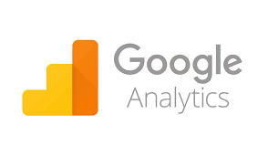
CASE STUDY
OPTIMIZELY AND GOOGLE ANALYTICS
About Optimizely –
Optimizely is a leading website and mobile app testing and optimization platform.
It offers innovative, data-driven marketing solutions for its clients.
Over 8,000 customers and 7 billion optimized experience.
Located in San Francisco, California

Slide 39
GOALS
The company was looking for an equally data-driven solution to provide rich users insights and bring users back.
Use a data-driven analytics platform that’s native to Google AdWords.

Slide 40
APPROACH
Used Google Analytics to create unique virtual page views to identify where customers were in sales Funnel.
Organized remarketing lists in Google Analytics for each funnel stage, then used AdWords to serve customize and relevant messages

Slide 41
RESULT
More cost efficiencies, with costs-per-click(CPC) 59% lower than in Optimizely’s non-remarketed Google campaigns.
With only 8.1% of Optimizely’s ad spend with Google, the remarketing campaigns generated more than 13% of all clicks.
Successfully moved leads through the funnel.
Customers loved Optimizely’s creative approach to ads

Slide 42
CONCLUSION
Incorporating advanced technology into business processes is the primary strategy for Businesses undergoing digital transformation.
With improvements in cost, efficiency, and customer experience, Businesses will continue to heavily invest in new tech solutions.
IT solutions which use automation are more popular than ever among small businesses as the cost of implementation continues to become more affordable.
Advanced technology solutions help companies achieve and maintain a competitive advantage in their industry. Through leveraging the tools available, they can increase staff productivity and decrease costs, the business can enjoy higher operating capacity and deliver a superior customer experience.

Slide 43
THANK YOU !

